Slide 1
What’s wrong with this data visualization?
Adapted for CGT 2700 Data Visualization
Group 14

Slide 2
Group 14
Group Members
Instructions
Staples, Zachary (Scribe)
Forestal, Cole
Hamilton, Seth
Luo, David
Examine the visualization on the next slide
Determine what’s wrong with the visualization
Then, provide recommendations on how the group would REFINE the visualization
Use any of the resources mentioned in previous lectures and readings

Slide 3
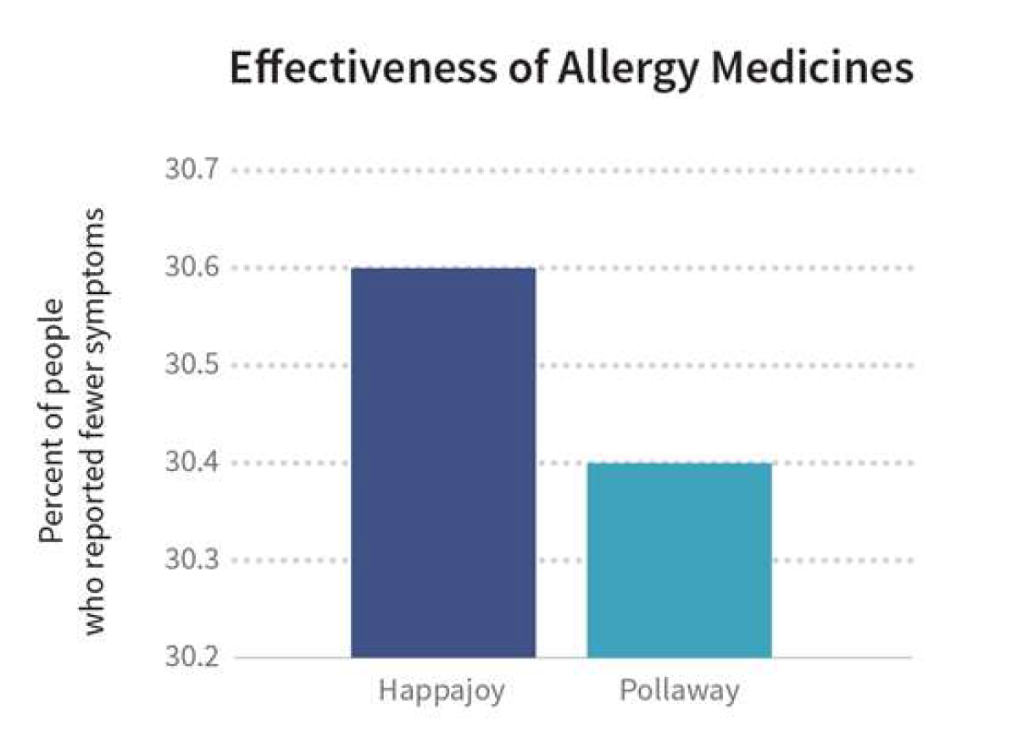

Slide 4
What is it?
This graphic compares the effectiveness of two allergy medicines

Slide 5
What’s wrong with it?
Side Text is too long, could be condense down.
No category labels.
Number Value are messed up
Mislead/Confusing overall picture.

Slide 6
What should they have done?
Possibly use a different graph.
Start the number value at 0 for a bar graph
Clean up and condense the overall picture
Label more things.

